Slide 1
Heart Disease Classification using Ensemble Learning
Name: Arghyadeep Mondal
Exam Roll: 19419CMP001
Sem: IV
Session: 2020-2021
Banaras Hindu University
Supervisor: Dr. Manoj Kumar Singh

Slide 2

Abstract
Machine Learning Use Case
Predict Heart Disease
The main objective of this project is to develop an Artificial Intelligence model using several Machine Learning approaches.
It retrieves data from a dataset which is downloaded from Kaggle website and compares the user provided values with the train dataset.
It can answer complex queries for diagnosing heart disease and thus assist healthcare practitioners to make intelligent clinical decisions which traditional decision support system doesn’t.
By providing effective treatments, it also helps to reduce the treatment cost.

Slide 3
Objective and Approach
Now a days, heart disease is a most common factor in human’s life after a certain age. As of 2016, according to WHO 17.9 million people which contributes 32% of total world deaths die due to heart disease. And the most surprising case is, 85% of the mentioned death was due Heart Attack and Stroke. At the turn of the century, cardiovascular diseases (CVDs) became the leading cause of mortality in India. This epidemiological transition is largely because of the increase in the prevalence of CVDs and CVD risk factors in India. In 2016, the estimated prevalence of CVDs in India was estimated to be 54.5 million. One in 4 deaths in India are now because of CVDs with heart disease and stroke responsible for >80% of this burden.
As far as we have seen, Machine Learning and AI such analytical tools are very productive in case of predicting heart disease for a patient. There are several approaches or models we can use for such classification problem like traditional machine learning classifiers, Logistic Regression, K-Nearest Neighbor, Naïve Bayes, Decision Tree, Random Forest and Support Vector Machine. For better accuracy and less overfitting/underfitting issues some Deep Learning Models are deployed such as Artificial Neural Network, Deep Neural Network, Fuzzy Neural Networks. These Deep Learning models are very accurate but computationally complex. In this paper we are going use several Ensemble Learning approaches to predict heart disease which are more accurate than traditional Machine Learning models and less complex than Neural Networks.

Slide 4
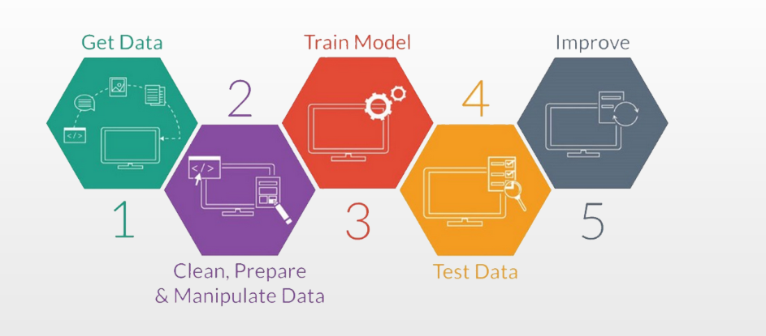
Used Tools
Data Prepossessing
Handle missing value
Exploratory Data Analysis
Balancing Dataset
Feature Selection
Traditional Classifiers
Logistic Regression
KNN
SVM
Decision Tree
Naïve Bayes
Ensemble Classifiers
Random Forest
Extreme Gradient Boosting
Light Gradient Boosting
Stacking Classifier

Slide 5
Why Ensemble Learning??
The main idea behind the Ensemble Learning is building multiple models instead of a single model to predict the target or future.
There are two main reasons to use an ensemble over a single model, and they are related.
Performance: An ensemble can make better predictions and achieve better performance than any single contributing model.
Robustness: An ensemble reduces the spread or dispersion of the predictions and model performance.
In terms healthcare data analysis where, most optimality is expected on a dispersed a dataset. Ensemble Learning provides several fruitful approaches.

Slide 6
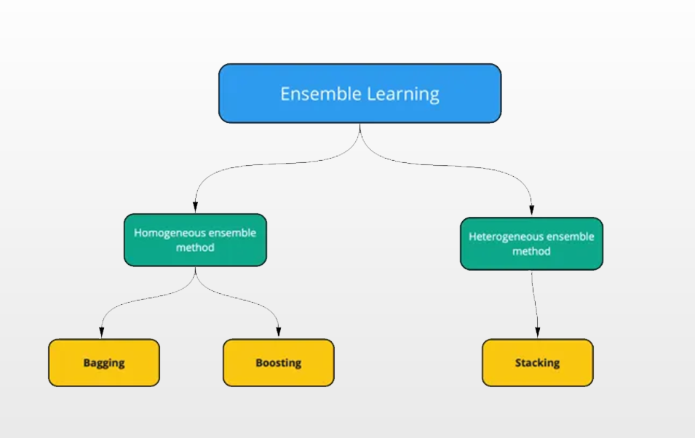
Different Ensemble Learning Methods
Homogeneous ensemble methods: - All the models are built using the same machine learning algorithm. Examples: Bagging, Boosting.
Heterogeneous ensemble methods: - All the models are built using different machine learning algorithms. Examples: Stacking.

Slide 7
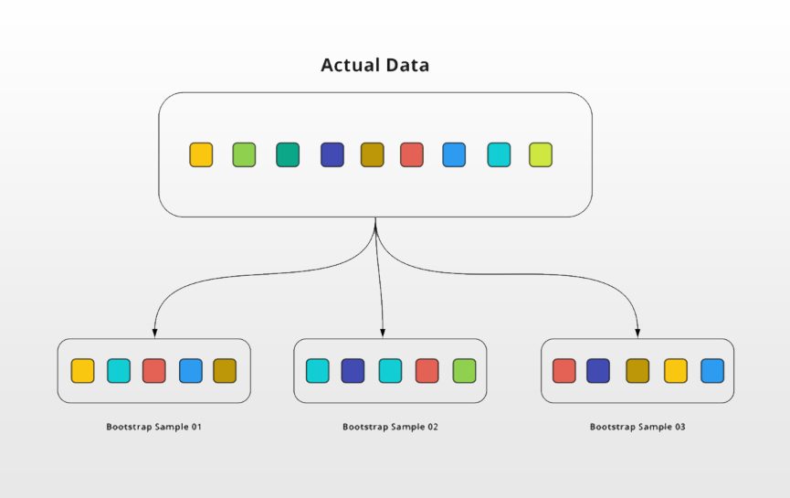
Bootstrapping
Bootstrapping is a statistical method to create sample data without leaving the properties of the actual dataset. The individual samples of data called bootstrap samples.
Bootstrapping

Slide 8
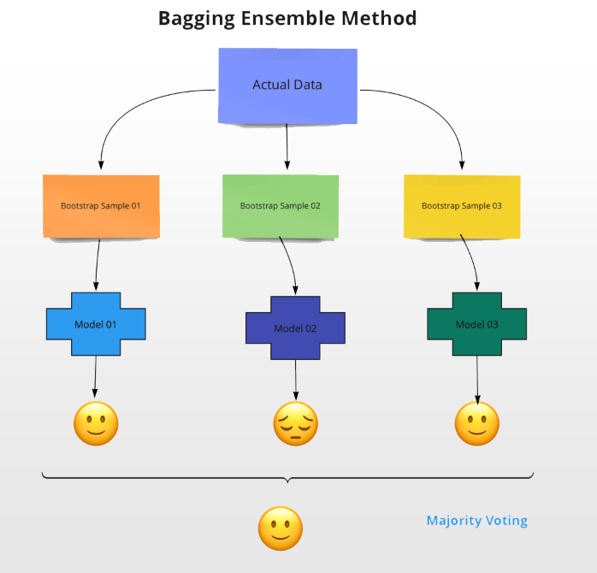
Bagging
In the bagging method, all the observations will have equal at zero weightage. Because of this bagging method also called Bootstrap Aggregating.
As a first step using the bootstrapping method, dataset will be split into N number of samples. Then the algorithm will be applied to all parallelly. Say Decision Tree is chosen.
Once the training phase is completed, to predict the target outcome, we will pass the observations to all the N decision trees. Each decision tree will predict one target outcome. The final prediction target will be selected based on the majority voting.
Example: Random Forest

Slide 9
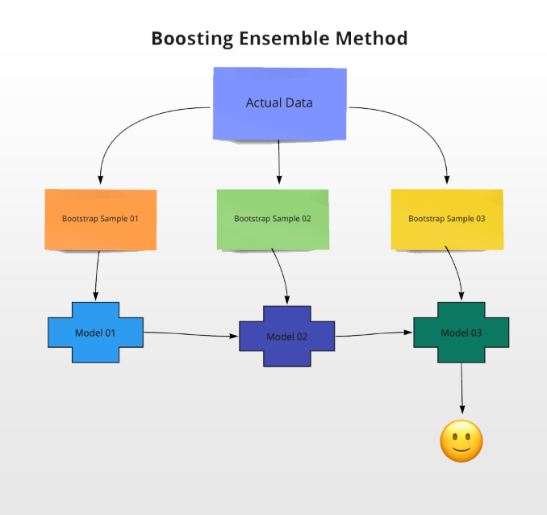
Boosting
In the boosting method, all the individual models are built sequentially. Which means the outcome of the first model passes to the next model and etc.
Unlike bagging all the observations in the bootstrapping sample are not equally treated in boosting. Observations will have some weightage. For a few observations, the weightage will be higher whereas others may be lower.
Example: Adaboost, XGBoost, LightGBM, CatBoost, LPBoost, GradientBoost, BrownBoost etc.

Slide 10
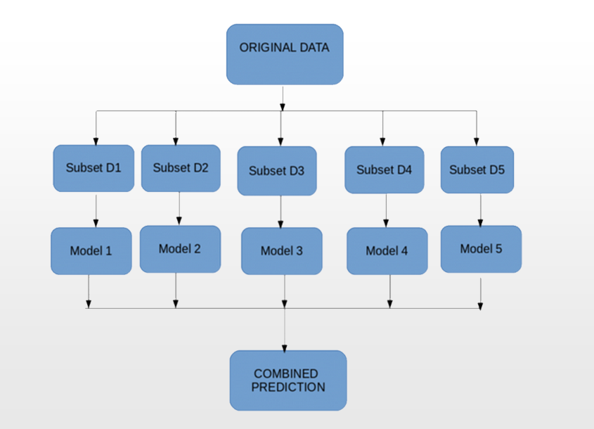
Stacking
Stacking is an ensemble learning technique that uses predictions for multiple models to build a new model. This final model is used for making predictions on the test dataset. The final model is called Meta Model.
The benefit of Stacking is that it can harness the capabilities of a range of well-performing models on a classification or regression task and make predictions that have better performance than any single model in the ensemble.
Stacking

Slide 11
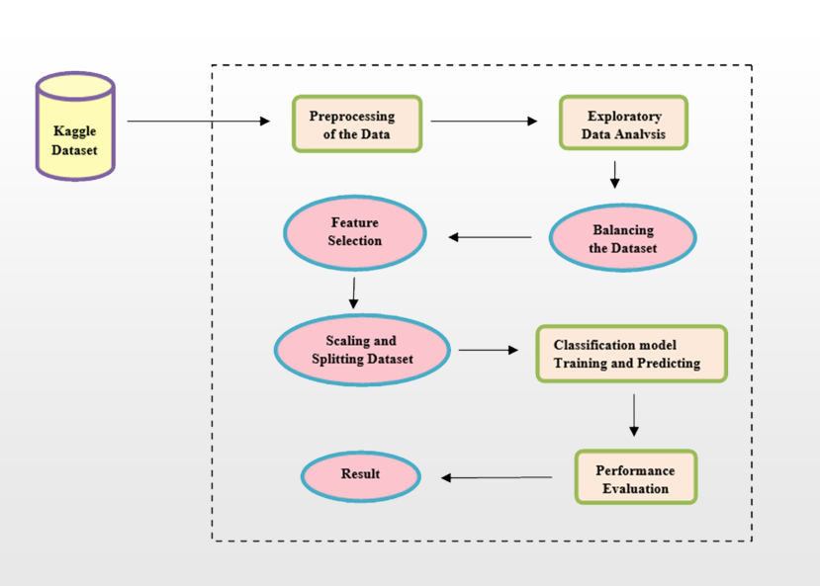
Flow of the Process
Flow of the Complete Process

Slide 12
Implementation
Used Tools
To satisfy the need of tools and their purposes that are required to set the process up are given below:
NumPy, Pandas – For Dataset handling
Seaborn, Matplotlib – Data Visualization
Warning – Blocking various kind of unwanted warning
Scikit-learn – One of the most useful modules for feature selection, scaling, splitting, model selection, and performance evaluation.
XGBoost – For Extreme Gradient Boosting Model
LightGBM – For Light Gradient Boosting Machine Model
Mlxtend – For Stacking Classifier Model
Imblearn – For balancing the dataset to get better accuracy for some algorithm.
Software Used
Mozilla Firefox
Windows 10 as Operating System Platform
Google Colaboratory for Python 3 Language IDE
Hardware Configuration
12.69 GB of Main Memory
107.72GB of Disk Space
And an additional GPU for performance acceleration.

Slide 13
Data Preprocessing & EDA
Handling Missing Values
Its one of the most important part of the process falls in the category of Data Preprocessing. There are so many missing values present in this dataset, some are filled by using several statistical measures and some are simply dropped.
Exploratory Data Analysis
Exploratory data analysis is performed to find out the insights of the dataset. Two types of analysis have been performed
Univariate Analysis
Single Attribute Distribution is shown
Bivariate Analysis
Relation between two variable have been shown.

Slide 14
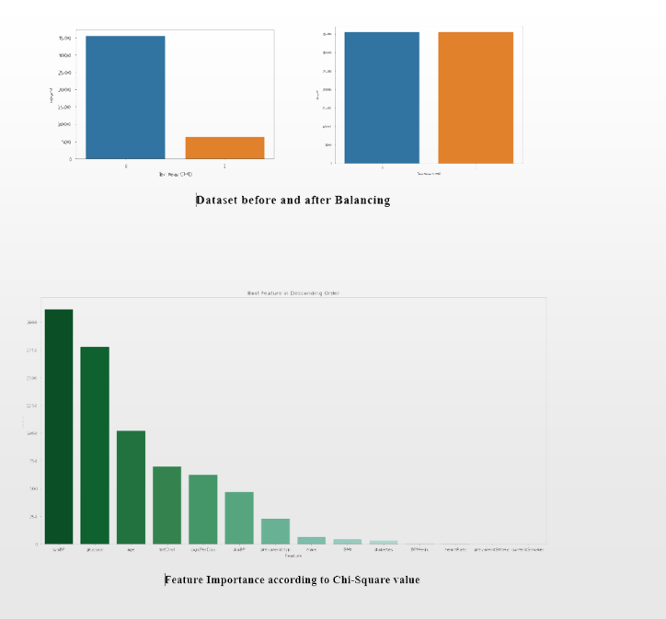

Data Preprocessing(Continued)
Balancing The Dataset
As the dataset was imblanced, balancing operation was performed to balance the dataset for better accuracy using SMOTE (Synthetic Minority Oversampling Technique ).
Feature Selection
Univariate feature selection method is used to get the best 10 features among 13 by their χ² value calculated.
$χ2$ = $\sum_{i=1}^{k}{\left[\frac{{\left({Observed}_{i} − {Expected}_{i}\right)}^{2}}{{Expected}_{i}}\right]}$

Slide 15
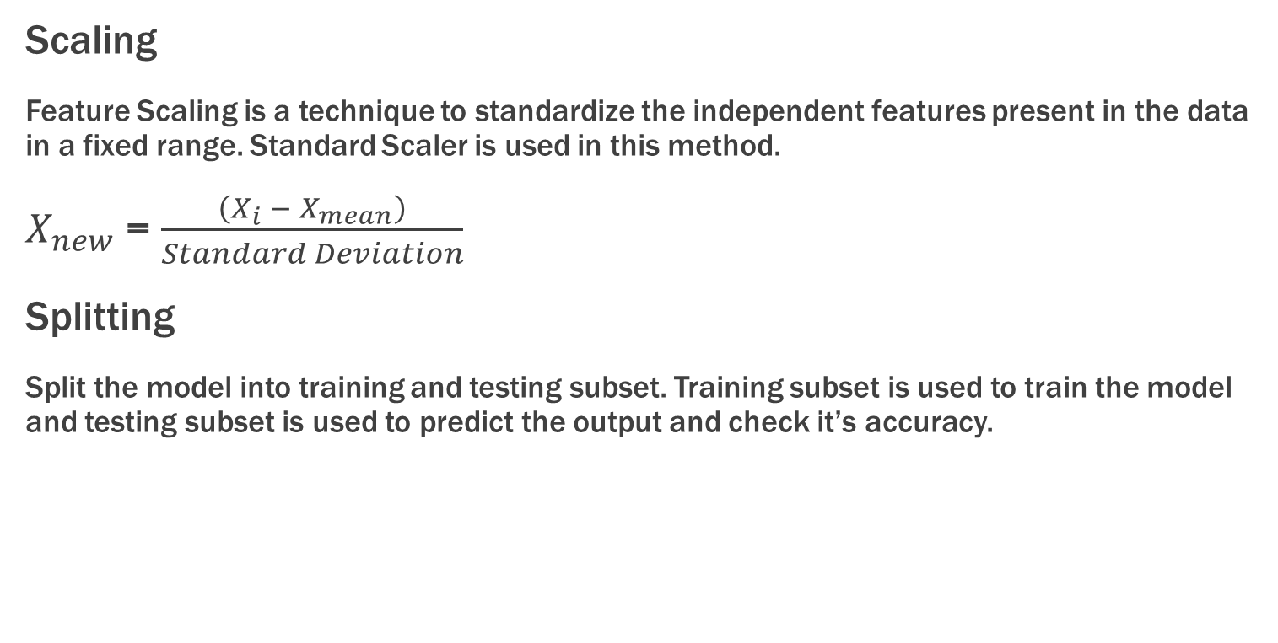
Data Preprocessing ( Continued )
Scaling
Feature Scaling is a technique to standardize the independent features present in the data in a fixed range. Standard Scaler is used in this method.
$X_{new}$ = $\frac{\left(X_{i} − X_{mean}\right)}{Standard Deviation}$
Splitting
Split the model into training and testing subset. Training subset is used to train the model and testing subset is used to predict the output and check it’s accuracy.

Slide 16
Predictive Modelling
Single Models
Some traditional Single Classifier used in this system to compare their accuracy with Ensemble Classifier.
Logistic Regression
K-Nearest Neighbor
Decision Tree
Support Vector Machine
Naïve Bayes

Slide 17
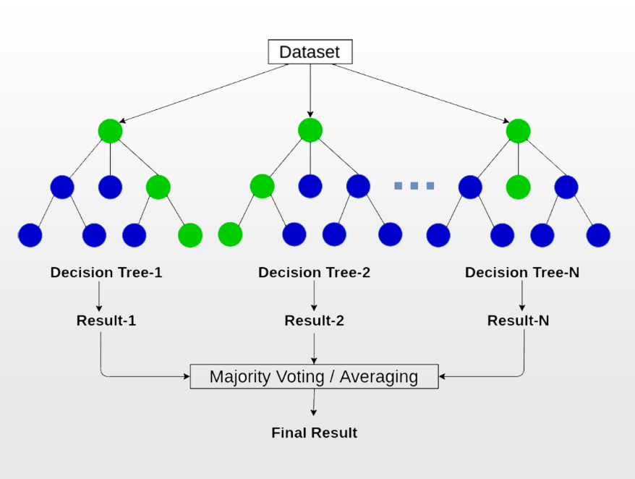
Random Forest
Random forest is a ensemble supervised machine learning approach which generate multiple decision trees simultaneously by splitting the training data into random multiple subset. Using more decision trees give more accuracy and robustness instead of using a single decision tree model. Once the output is generated in each decision tree Random Forest algorithm takes the final output by using majority voting method.
It can be used for both classification and regression problems.
Random Forest

Slide 18
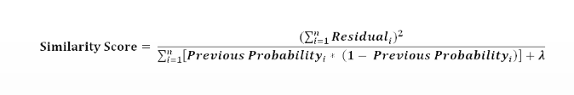


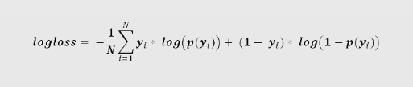
Extreme Gradient Boosting
Extreme Gradient Boosting or XGBoost is a supervised ensemble learning approach used for both classification and regression problems. It's a advanced form of Gradient Boosting which follows also tree based structure and boosting mechanism to reduce error.
It uses Similarity Score and Gain function for splitting the node.
Some important parameters are: Lambda, Eta, Gamma.
Evaluation function used in XGBoost are loss, logloss, MSE, MAE, RMSE.

Slide 19
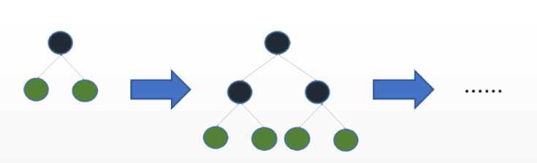
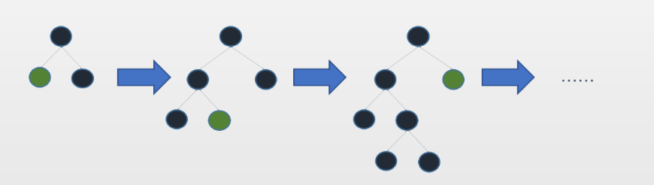
Light Gradient Boosting Machine
Light Gradient Boosting Machine or LGBM is a form of Gradient Boosting mechanism, which is known for its higher accuracy, less time complexity, less memory usage, supporting parallel and GPU learning, and efficiency of large-scale data handling.
Optimality in LGBM can be achieved in two ways:
Speed and Memory Usage:
Histogram- based algorithms are used to transform continuous features into discrete bins in LGBM algorithm, resulting enhanced speed and accuracy of the overall performance.
Accuracy:
LGBM grows trees vertically or leaf wise which means the leaf which has maximum delta loss is chosen and the tree continues to grow from there. Leaf wise algorithms are more efficient in reducing more loss than level wise algorithms when growing the same leaf. This method is called Gradient Based One Side Sampling.
Level-wise Tree Growth in other Boosting Algorithm
Leaf-wise Tree Growth in LGBM

Slide 20
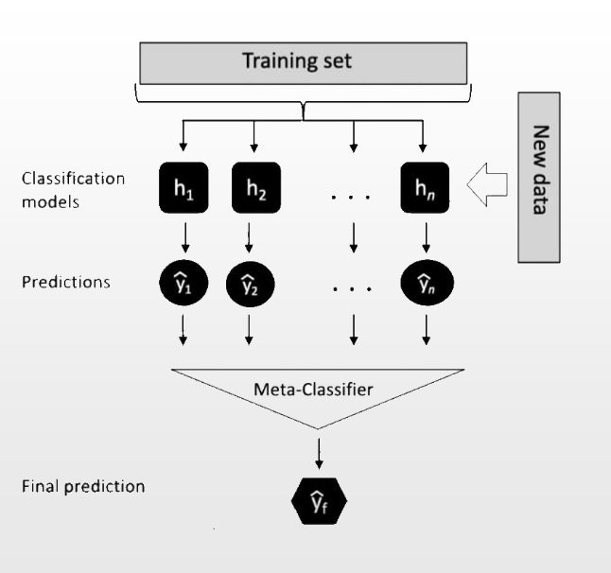
Stacking Classifier
Stacking Classifier is an ensemble learning method, which uses heterogeneous models instead of homogeneous models to predict output. For predicting mechanism, a collection of Base Models and a Meta-Model is used in Stacking Classifier.
Base Model - Weak Models that are used to train in previous step of the algorithm.
Meta-Model – Ultimate strong model that take the output of the Base Model’s and predict the actual output.
Stacking Classifier

Slide 21
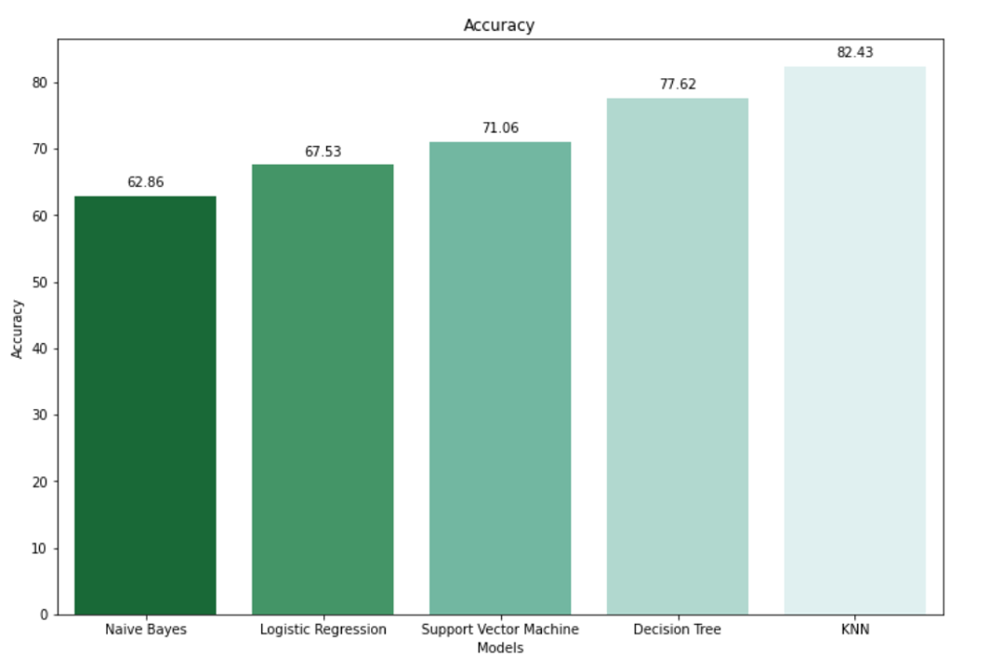
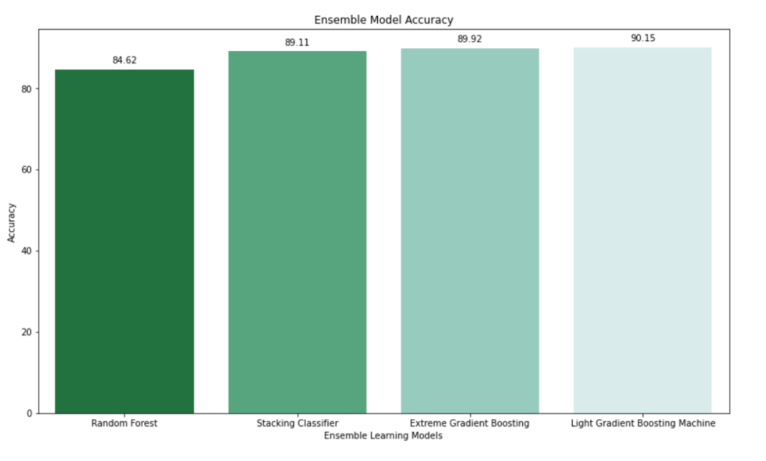
Results
Accuracy of Single Models
Accuracy of Ensemble Models

Slide 22
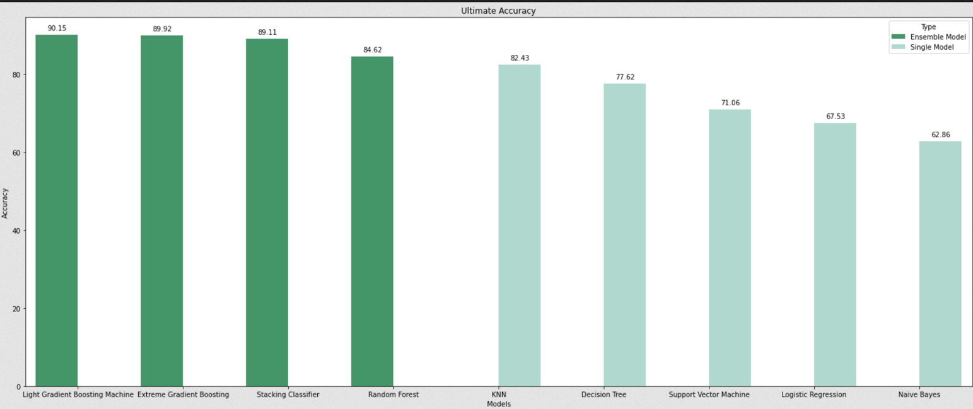
Result Comparison
Accuracy comparison of Different Model

Slide 23
Conclusion and Future Work
Conclusion
In this project, a Machine Learning based system is designed to predict heart disease risk for future 10 years. After preprocessing, and exploratory data analysis, several models are built such as Single Model like Logistic Regression, KNN, SVM, Naive Bayes, DT and Ensemble model like LGBM, XGBoost, Stacking Classifier and Random Forest. The focus of this project is to show how Ensemble Learning model can be more accurate and robust than the Single Models. It’s clearly seen from these above diagram that every Ensemble models simply outperformed single models. Light Gradient Boosting Machine has the best performance for this dataset, having accuracy of 90.15%. But Extreme Gradient Boosting and Stacking Classifier come very close with the accuracy of 89.92 and 89.11 respectively. Naive Bayes has the worst performance in this system with 62.86% accuracy score. The information derived from these method, can predict with accuracy whether a person may or may not face heart disease risk in future 10 years.
Future Work
Things that are required in future, to make this system more demanding mentioned below
Hyperparameter Tuning
Combine this system with a chatbot in a cloud-based GUI application

Slide 24
Thank You

